Slide 1

November 3, 2024
Laurel-Jones County Public Library Strategic Plan 2024-2028
Presented To
Karyn Walsh, Library Director
Presented By
LIS 605 Library Management Strategic Group:
Jessica Yurkow, Jessica.Yurkow@usm.edu
Virginia Panter, Virgina.Panter@usm.edu
Celine Petrus, Celine.Petrus@usm.edu
Abigail Hummell-Bell, Abigail.Hummel@usm.edu
Hannah Crump, w10180816@usm.edu
Angela Massengale, Angela.Massengale@usm.edu
Grace Beikman, Grace.Beikman@usm.edu

Slide 2
Table of Contents
Library Information & History | 2
Community Profiles | 3
Mission Statement | 6
Vision Statement | 6
Values | 7
Goals & Objectives | 8
Evaluation Plan | 13
Timeline | 14
Stakeholder Involvement | 15
References | 17

Slide 3
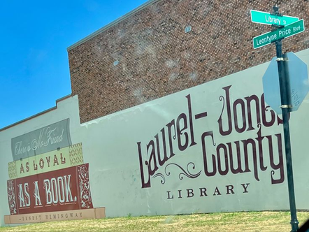
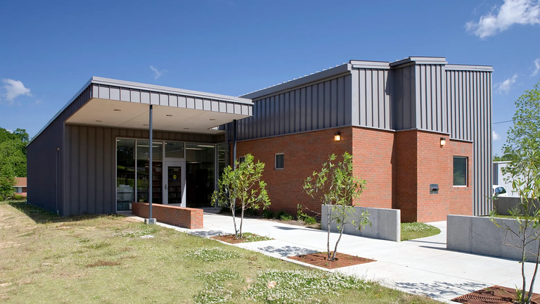
Library Information and History
Lead Author: Grace Beikman
The Laurel-Jones County Library System
1
https://laurel.lib.ms.us/
LJCLS provides materials, services, and programs for all ages. The library’s collection includes audiobooks, eBooks, video games, DVD and Blu-Ray movies, the Library of Things, Children’s Learning Kits, and books for adults, young adults, and children. The library also has computers for public use, laptops for check-out, Children’s Learning Area, and a Genealogy Department (Laurel-Jones County Library only). Programs include children’s storytimes, book clubs, summer reading, and many more.
See the LJCLS website listed above for more information.
Laurel-Jones County Library
580 Commerce St, Laurel, MS, 39440
The Laurel-Jones County Library was originally inaugurated as the Laurel Library Association in 1919. By 1923, the library had moved to the Lauren Rogers Museum, and in 1966, the library became a free, public library. The current location of the library was established in 1979 and acts as the center of operations for the Laurel-Jones County Library System.
2
Laurel-Jones County Library. From Pinterest.
Ellisville Public Library
201 Poplar St, Ellisville, MS, 39437
The Ellisville Public Library was created by the Fidelia Club of Ellisville in 1967 and was first located in Ellisville City Hall. In 1988, the library became a part of the Laurel-Jones County Library System, and a new building was established in 2009.
2
Ellisville Public Library. From Burris/Wagnon Architects, PA.
  Home page. (n.d.). Laurel-Jones County Library System. https://laurel.lib.ms.us/.
  About us. (n.d.). Laurel-Jones County Library System. https://laurel.lib.ms.us/about/.
2

Slide 4
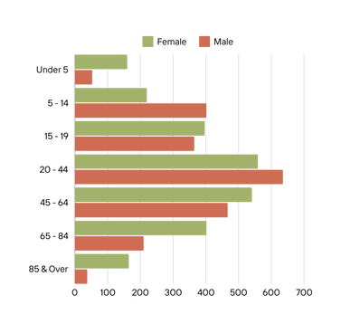
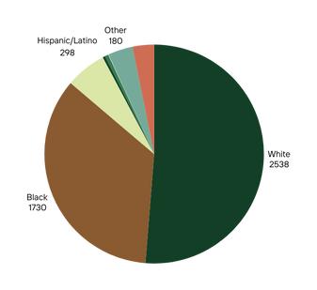
Community Profiles
Lead Author: Grace Beikman
Statistics from U.S. Census Bureau
Ellisville, Mississippi
1
Population 4,652 (2020)
31.6% Poverty Rate (2022)
$30,479 Median Household Income (2022)
33% Employment Rate (2022)
EDUCATIONAL ATTAINMENT
19.6% Bachelor’s or Higher (2022)
29.4% High School or Equivalent (2022)
HEALTH
23.9% with Disabilities (2022)
12.8% w/o Health Coverage (2022)
Age and Sex Distribution
Race/Ethnicity Distibution
  Ellisville city, Mississippi. (n.d.). U.S. Census Bureau. https://data.census.gov/profile/Ellisville_ city,Mississippi?g=160XX00US2822020.
3

Slide 5
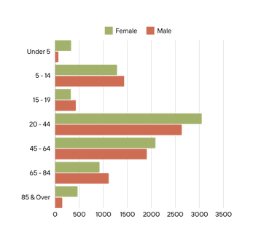
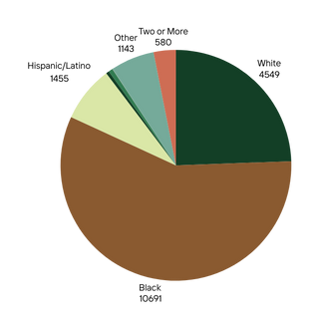
Community Profiles
Lead Author: Grace Beikman
Statistics from U.S. Census Bureau
1
Laurel, Mississippi
Population 17,161 (2020)
32.6% Poverty Rate (2022)
$36,336 Median Household Income (2022)
49.3% Employment Rate (2022)
EDUCATIONAL ATTAINMENT
21.9% Bachelor’s or Higher (2022)
33.9% High School or Equivalent (2022)
HEALTH
19.3% with Disabilities (2022)
12.5% w/o Health Coverage (2022)
Age and Sex Distribution
Race/Ethnicity Distibution
  Laurel city, Mississippi. (n.d.). U.S. Census Bureau. https://data.census.gov/profile/Laurel_ city,Mississippi?g=160XX00US2839640.
4

Slide 6
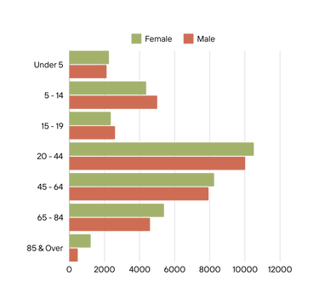
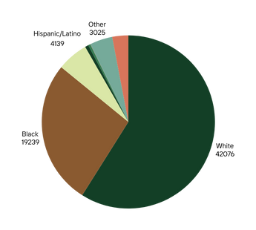
Community Profiles
Lead Author: Grace Beikman
Statistics from U.S. Census Bureau
1
Jones County, Mississippi
Population 67,246 (2020)
19.7% Poverty Rate (2022)
$48,503 Median Household Income (2022)
54.5% Employment Rate (2022)
EDUCATIONAL ATTAINMENT
20.6% Bachelor’s or Higher (2022)
30.3% High School or Equivalent (2022)
HEALTH
20.9% with Disabilities (2022)
15.8% w/o Health Coverage (2022)
Age and Sex Distribution
Race/Ethnicity Distibution
  Jones County, Mississippi. (n.d.). U.S. Census Bureau. https://data.census.gov/profile/Jones_ County,Mississippi?g=050XX00US28067.
5

Slide 7



Mission Statement
Lead Author of Statements: Hannah Crump
Our purpose is to enrich the lives of our community by empowering our citizens’ personal, educational, and professional growth. The library is dedicated to providing free and open access for advancing literacy, fostering lifelong learning, and supporting the diverse cultural needs within our community.
Connect
Empower
Grow
Vision Statement
The Laurel-Jones County Library System serves the community as a focal point for the following: information accessibility, gathering, enrichment, and intellectual discovery through creative programming, wide-ranging collections, responsive services, and inclusive support of diversity, culture, and intellectual freedom.
6

Slide 8
Values
Lead Author: Virginia Panter
The Laurel-Jones County Public Library looks to the ALA Cores of Librarianship for guidance on the values of our library. Our values are providing access to the community, maintaining creativity, and growing our knowledge.
Community: We focus on putting our community first, wanting our patrons to be comfortable and welcomed in our library. We make sure that access to any library materials and services are available to everyone who arrives inside our doors, calls our desks, or visits our website.
Creativity: The library is a safe space to foster creativity, for our employees as well as our patrons. Never is there a dull day in the library and we want to encourage that growth for the sake of our community.
Knowledge: In order to provide the best service we can, we are always looking to expand our knowledge and abilities. Every day, we learn something new and we use that to cater towards our community.
American Library Association (January 2024). Core values of librarianship.
https://www.ala.org/advocacy/advocacy/intfreedom/corevalues
Mississippi Library Commission. About. https://www.mlc.lib.ms.us/about/
University of Washington. Libraries mission, vision, and values.
https://lib.uw.edu/about/intro/mvv/
7

Slide 9




Goals & Objectives
Lead Author: Jessica Yurkow
Provide technology to help our community stay informed and connected.
Reshape the role of the library in our community
Foster personal growth and connection within the community
Provide patrons with equitable access to information
8

Slide 10


GOAL 1:
Provide technology to help our community stay informed and connected.
Objective 1
Provide up-to-date computers at the library and circulating hotspots for at-home internet access
Plan of Action
  Our top priority is to replace all library computers over three years. The first year of our plan includes replacing staff desktop computers and library catalog computers by the end of 2026. Following this will be an update to all public-use computers in 2027 to meet the needs of our patrons who rely on the library for computer software and internet access. In 2028 - the third year of our plan - we plan to replace laptops needed for staff use.
  To foster our community member’s ability to stay informed and connected outside of the library, we are renewing the current licensing for all of our circulating tablets and hotspots in 2026. In 2028, we plan to add 5 more hotspots and 5 more tablets to our collection, so we can serve more patrons at one time.
9

Slide 11
GOAL 2:
Reshape the role of the library in our community
Objective 2
Provide communal spaces that enhance the library experience for patrons of all needs and abilities.
Plan of Action
  A makerspace will be implemented in 2026 to support the inventive, creative, and innovative needs of our patrons. A 3D printer will be the first technological addition to this space. In 2027 a sewing machine will be added to the space -including sewing supplies like bobbins, needles, fabric scissors, tape measure, thread, pins, hand-sewing needles, and pin cushions available for public use on a first come first serve basis.
  A “Sensory Space” to provide tactile and visually calming experiences to support patrons with sensory processing needs, anxiety disorders, autism, or other needs implemented in 2028. With the addition of a part-time grant writer to library staff, our goal is to fund purchases of a Vibroacoustic Easy Chair and Musical Touch-Wall with grant money designated to special-needs compliant spaces.
  Achieving this goals means designating specially trained staff to manage these spaces and provide patron support as needed.
10

Slide 12
GOAL 3:
Foster personal growth and connection within the community
Objective 3
Partner with Jones College to create enhanced educational opportunities for students 17 and up interested in pursuing careers in librarianship.
Plan of Action
  Students who are enrolled or high school seniors planning to enroll in the Library and Information Science Transfer Pathway Program at Jones College are welcome to participate in the “Shadow a Librarian” work-study program at the library, starting in the fall of 2027. This program follows the guidelines of Federal Work Study and will provide a hands-on opportunity for students to learn about library services.
  Participants can shadow a librarian in adult reference, youth services, or marketing. A librarian from each department will be elected to be the team lead on the shadowing project. The success of this endeavor will be measured by community interest and the advancement of the participants as they pursue careers in the library field.
  Students in this program will get first-hand exposure to library work, helping them build knowledge and confidence in the field while acquiring experience to put on their resumes.
11

Slide 13
GOAL 4:
Provide patrons with equitable access to information
Objective 4
Create points of access for patrons who live in rural areas or may be unable to physically visit the library for any reason.
Plan of Action
  In 2026 Uline Book Lockers will be available at both branches. These lockers enable access to information by allowing patrons to pick up holds whenever it is convenient for them. We understand that everyone in our community is on a unique schedule and may not be able to get to the library during regular business hours.
  With only a little over 25% of our goal left, through the help of our stakeholders and additional grant funding we aim to have the Book Trolley on the road in 2026. It will be equipped with a circulating book collection and also be used as a space for programming and activities. The trolley enables us to bring equitable access to information by bringing the library to our neighbors in rural areas who otherwise may not be able to regularly visit the library
12

Slide 14

Evaluation Plan
Lead Author: Angela Massengale
Are technology upgrades meeting staff, patron, and community needs? | Collect tech usage data from patrons Survey/feedback forms about tech from patrons | Increased access to technology and engagement with computers, hotspots, and tablets; efficient operations for staff
2. Are tech replacements staying within budget and on projected timeline? | Regular in-person meetings between IT and budgeting teams Progress reports to key stakeholders | All upgrades within budget and on proposed timeline, transparency, and fiscal responsibility
3. How effectively are new spaces ( maker and sensory) being managed and utilized? | Gather space usage data ( i.e. attendance) Survey library staff and patrons to gauge satisfaction collect feedback and improve spaces | Community building, increased civic engagement, reshaping the role of the library in the community
4. Is there a measurable increase in community engagement through new programs ? ( book locker, trolley, and Shadow a librarian) | Track usage/circulation statistics for book locker and trolley interview students and/or collect testimonials from previous participants in Shadow a Librarian program Student participation numbers | Points of access for patrons in rural areas, community outreach, foster personal growth
Key Questions
Assessments
Outcome
At the end of each fiscal year, all senior members of the library staff involved in the implementation of these goals will meet with the stakeholders to share progress updates and roadblocks and to assess if any additional technology or community needs have arisen that might need to be considered or included in the strategic plan.
13

Slide 15





Timeline
Lead Author: Celine Petrus
2025
2026
2027
2028
  Replace staff desktop and library catalog computers
  Add part time grant writer to staff
  Replace public-use computers
  Maker Space ( 3D printer)
  renew current licensing and hotspots
  Uline Book lockers at both branches
  Start up of Book Trolley
  Replace laptops needed for staff
  Maker Space: add sewing machine and supplies
  “Shadow a Librarian” Work-study implementation
  Add 5 more hotspots
  Add 5 more tablets
  Sensory Space: Vibroacoustic chair, musical touch wall
Community feedback is a vital part to our success, and as such will be collected throughout all years to measure satisfaction
14

Slide 16


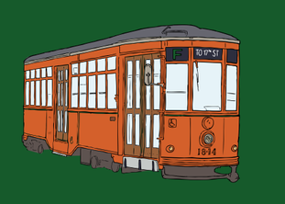
Stakeholder Involvement
Lead Author: Abigail Hummell-Bell
Current Stakeholders
  Library Board of Directors
  Friends of the Laurel County Jones Library
  Community
Stakeholder Involvement
Friends of the Laurel-Jones County Library, Facebook
By creating, advertising, and participating in fundraisers, the Friends of the Library group are raising money to further the mission and goals of the library.
Popup Book Fair, Facebook
The library currently has raised 73% of their $100,000 goal by the generous donations from sponsors and the community.
Suggestions:
Trolley Fundraiser, Laurel-Jones County Library
To keep funding incoming to support our libraries’ goals and keep our Friends of the Library group active, we want to suggest there be a section in the library that houses donated books and DVD’s available for purchase year round. The book sale could be staffed by volunteers from the Friends of the Library group, and occasionally by the high school seniors that are a part of the “Shadow-a-Librarian” program so that they can get experience with implementing and participating in library programming
15

Slide 17
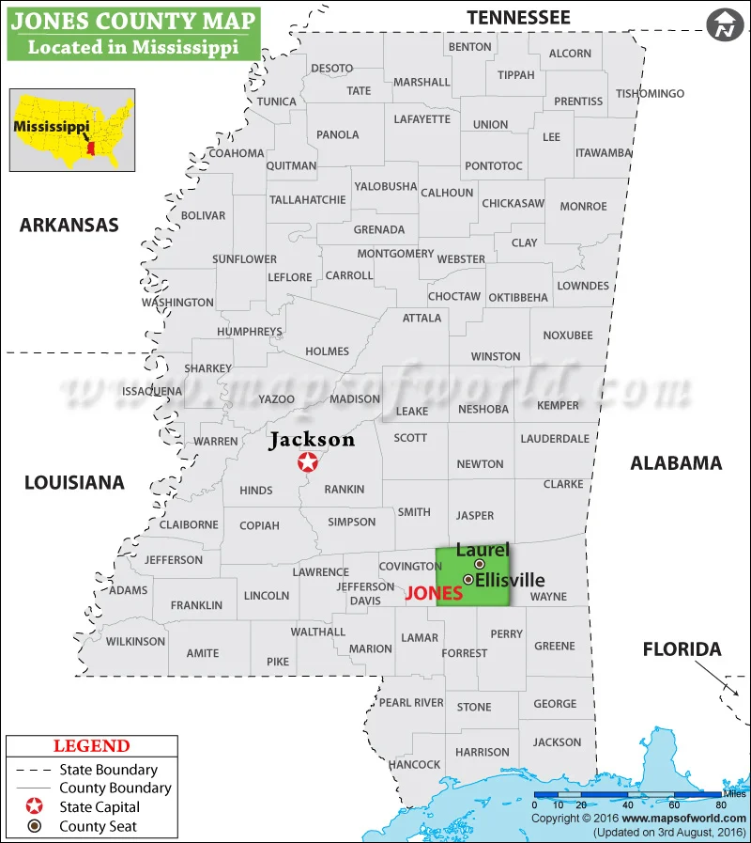
November
2024
Jones county map, Mississippi [Image]. (2016). Maps of World. https://www.mapsofworld.com/usa/states/mississippi/counties/jones-map.html.

Slide 18
References
24 Hour Locker System — Red Bank Public Library. (n.d.). Red Bank Public Library. Retrieved November 18, 2024, from https://www.redbanklibrary.org/24hrlocker
About us. (n.d.). Laurel-Jones County Library System. Retrieved Nov. 17, 2024, from https://laurel.lib.ms.us/about/.
Burris/Wagnon Architects, P.A. (n.d.). The Ellisville public library [image]. Retrieved Nov. 17, 2024, from https://burriswagnon.com/?page_id=172.
Ellisville city, Mississippi. (n.d.). U.S. Census Bureau. Retrieved Nov. 17, 2024, from https://data.census.gov/profile/Ellisville_ city,_Mississippi?g=160XX 00US2822020.
Laurel Jones-County Library System (n.d.) Posts. [Facebook page] Facebook. Retrieved Nov. 24, 2024, from https://www.facebook.com/FriendsofJCLS
Laurel Jones-County Library System (n.d.) Trolley Fundraiser. laurel.lib.ms.us. https://laurel.lib.ms.us/trolley-fundraiser/
Home page. (n.d.). Laurel-Jones County Library System. Retrieved Nov. 17, 2024, from https://laurel.lib.ms.us/.
Jones County, Mississippi. (n.d.). U.S. Census Bureau. Retrieved Nov. 17, 2024, from https://data.census.gov/profile/Jones_ County,_Mississippi?g=050XX00US28067.
Laurel city, Mississippi. (n.d.). U.S. Census Bureau. Retrieved Nov. 17, 2024, from https://data.census.gov/profile/Laurel_ city,Mississippi?g=160XX00 US2839640.
Lough, M [Marie]. (n.d.). Mural on library building in Laurel [Pinterest post]. Retrieved Nov. 17, 2024, from https://www.pinterest.com/pin/ 180777372536150132/.
17

Slide 19
References
Sensory Space | Ocean County Library. (n.d.). Home | Ocean County Library. Retrieved November 18, 2024, from https://theoceancountylibrary.org/sensory-space
Sensory Space Equipment | Ocean County Library. (n.d.). Home | Ocean County Library. Retrieved November 18, 2024, from https://theoceancountylibrary.org/sensory-space/equipment#tactile-balls
Strategic Plan – Somerset County Library System of New Jersey. (n.d.). Somerset County Library System of New Jersey. Retrieved November 18, 2024, from https://sclsnj.org/about/strategic-plan/
Strategic Plan 2022-2024 | Brooklyn Public Library. (n.d.). Brooklyn Public Library. Retrieved November 18, 2024, from https://www.bklynlibrary.org/strategicplan
Trolley Fundraiser – Laurel Library. (n.d.). Laurel Library – Jones County Library. Retrieved November 18, 2024, from https://laurel.lib.ms.us/trolley-fundraiser/
18

